Slide 1
Field Progress App
Team 04: Akanksha Diwedy, Aishwarya Joisa, Kevin Grimes, Madhavi Shantharam, Mayank Kulkarni,Sahithi Velma, Uche Uba

Slide 2
Overview
Team’s Strengths and Weaknesses
System/Project Engineer Observations
Operational Concept Design
Win-Win Agreements
Prototype And Product Demonstration
Architecture
Life Cycle Plan
Feasibility Evidence
Quality Focal Point
Feedback

Slide 3
Team’s Strengths and Weaknesses
Presented by Kevin Grimes

Slide 4

Team’s Strengths and Weaknesses
Strong points
Considerable professional software development experience
Python and JavaScript
Collaborative work environments
Tool familiarity (Github, Jira, Slack, etc.)
Strong communication skills
Weak points
Distributed team members with busy schedules
Lack of experience in political and GIS domains
Strength icon: https://www.clipartwiki.com/downpng/ThJhJi_dumbbell-clipart-weight-room-transparent-strength-icon-png/
Notes:
Operational strength
Ease of communication
Using teleconferencing tools such as Zoom and other communication tools like Slack and e-mail, been able to keep in touch and get quick turnaround from colleagues on short notice
Technical strength
Software experience
Nearly all team members have software experience and have worked in teams at companies
Nearly all team members have used Python, JavaScript, and other tools mentioned
Great period of time to be a s/w developer, with all of the tooling available for teams
Operational weakness
Team (including clients) is distributed across multiple cities (LA, San Diego, Pasadena)
Several team members work full-time jobs
Technical Weakness
Few team members have worked in politics
Few team members have experience working with GIS

Slide 5

Team’s Strengths and Weaknesses
Technical concerns
Algorithm time complexity
Factors to consider: precinct size, number of volunteers, geographical features
Potential mitigator: limit input to reasonable parameters, increase hardware resources
Application module portability
Code is currently being developed as a Jupyter Notebook, an environment not designed for production
Potential mitigator: final product should be a well-documented Python module
Operational risks
Team distribution
Clients in San Diego, IIV&V in Pasadena
Potential mitigator: frequent teleconferences
Exponential growth icon: http://www.arborinvestmentplanner.com/wp-content/uploads/2012/09/ExponentialGrowth.jpg
Notes:
Time complexity
This application is geared toward managers of smaller campaigns (think precinct level). As long as inputs are restricted to that scale, the algorithm should finish on time
The algorithm should, however, be designed in such a way that it can scale vertically (that is, given more containers, it can run more quickly)

Slide 6
System/Project Engineer Observations
Presented by Kevin Grimes

Slide 7


System/Project Engineer Observations
Win-win shaping status
General consensus on priorities
Top priority: valid clustering of a precinct
Difficult, but also important: optimal clustering
Clients rated algorithm correctness verification highly
Overall project evaluation consideration
SCSs’ CRACKness
Complexity
Precedentedness
Use of communication tools
Skills/needs match
Knowledge/experience mismatches
Checkmark icon: http://clipart-library.com/clipart/rcLn4qBAi.htm; Warning icon: http://clipart-library.com/clipart/474600.htm
Notes:
CRACK: Collaborative, Representative, Authorized, Committed, and Knowledgeable

Slide 8
Operational Concept Design
Presented By Akanksha Diwedy

Slide 9
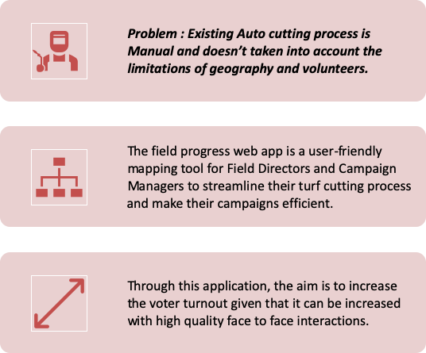
System Purpose

Slide 10
System Purpose
Efficient turf cutting algorithm which can take into account all possible limitations of volunteers and geography
The app should be able to take voter data, volunteer information as input and then determine possible and efficient turfs within one precinct.
Visualization of such information and the results of turf cutting algorithm is the final part of the task for this application.

Slide 11
Shared Vision
Assumptions •Current turf cutting process in not necessarily efficient. •Current system is too expensive and not easily accessible or available for smaller campaigns. •Volunteers will be able to talk to most of the voters assigned to them during their availability.
Stakeholders(Who?) | Initiatives(What?) | Value Propositions(Why?) | Beneficiaries(For whom?)
•Clients •Campaign Managers •Developers | •Design and develop a web application •Implement turf cutting algorithm | •The need for a better turf cutting process for campaigns. •Increasing the number of voters to be reached and spoken to. | •Campaign Manager •Volunteers •Candidates
Cost •Development costs •Maintenance costs •Database storage | Benefits •Measuring voter turnout •Increase in number of voters being reached to by the volunteers

Slide 12
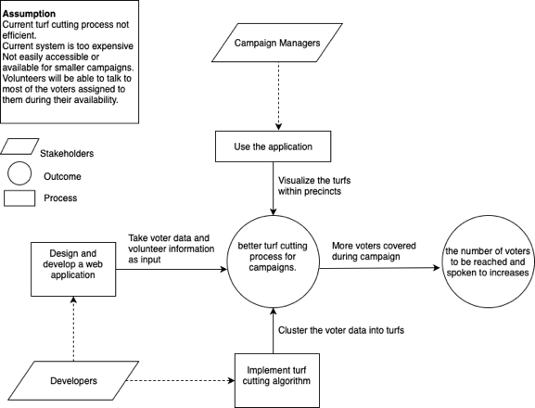
Benefit Chain Diagram

Slide 13
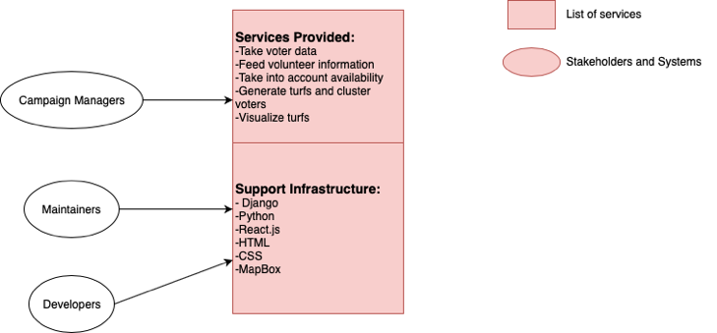
System Boundary

Slide 14
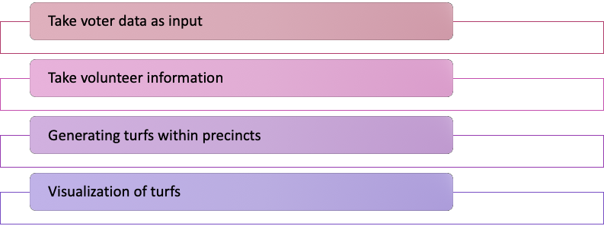
Core Capabilities

Slide 15
Capability Goals
Capabilities | Priority Level
Take voter data as input | High
Take volunteer information | High
Generating turfs within precincts | High
Visualization of turfs | Medium

Slide 16
Constraints
Browser Compatibility : The application should be compatible with commonly used browsers like Chrome, Firefox, and Safari.
MapBox Compatibility : Mapbox API allows efficient route between a minimum of 2 and maximum of 12 point locations on the map.
This generates the need of hierarchical clustering.
Monetary Funds : Limitations in terms of funds doesn’t allow use of Google Maps API because it starts billing after certain number of API calls.

Slide 17
Requirements Analysis
Presented By Mayank Kulkarni

Slide 18
Win-Win Agreements
Algorithm
WC_5695 | The project should scale well to increased voter data. | 0.426
WC_5508 | We can specify number of volunteers, time per volunteer, time per conversation, and likelihood of conversation as parameters. | 0.921
WC_5488 | The final product shall accept as input a variable number of volunteers. | 0.315

Slide 19
Win-Win Agreements
Testing
WC_5510 | A test framework for objectively verifying its effectiveness. | 0.660
WC_5491 | The final product shall be executable on Windows, Linux, and MacOS operating systems. | 0.079

Slide 20
Win-Win Agreements
Visualization
WC_5696 | Clustered voter data should be efficiently visualized on an interactive map. | 0.801
WC_5487 | The final product shall render an optional map with voters placed as points indicating the best route(s) for the volunteers to take. Representing the grouping of voters using colors. | 0.896

Slide 21
Prototype
Presented By Uche Uba

Slide 22

Prototype
Most Significant Capabilities of the product: Back-end (Django)
Take a list of voters data as an input. Typically in CSV format
Perform A Turf-Cutting operation on said list. Via the following process
Takes an input of precinct data (geoJSON polygon format), and then splits the voters into sections based on the precinct they fall under
It then performs a clustering on the voter data in each precinct, based on the number of volunteers available
The output of the above operations will be a geoJSON list of voters, with the cluster they belong to included in their properties
The output (geoJSON) is returned as a result of an api endpoint

Slide 23
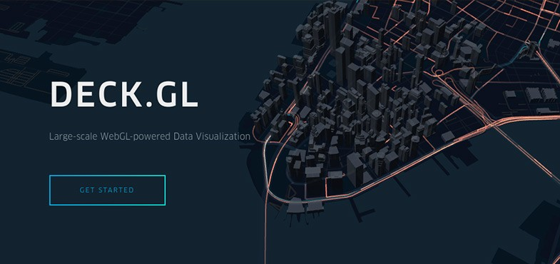


Prototype contd
Most Significant Capabilities of the product: Front-end (React)
It is able to account for volunteers by displaying an input form where volunteer information can be input
It sends the volunteer information as parameters for the http request to the server
It receives the response, parses it, and then utilizes 3rd party libraries like Mapbox and DeckGL to visualize the data

Slide 24
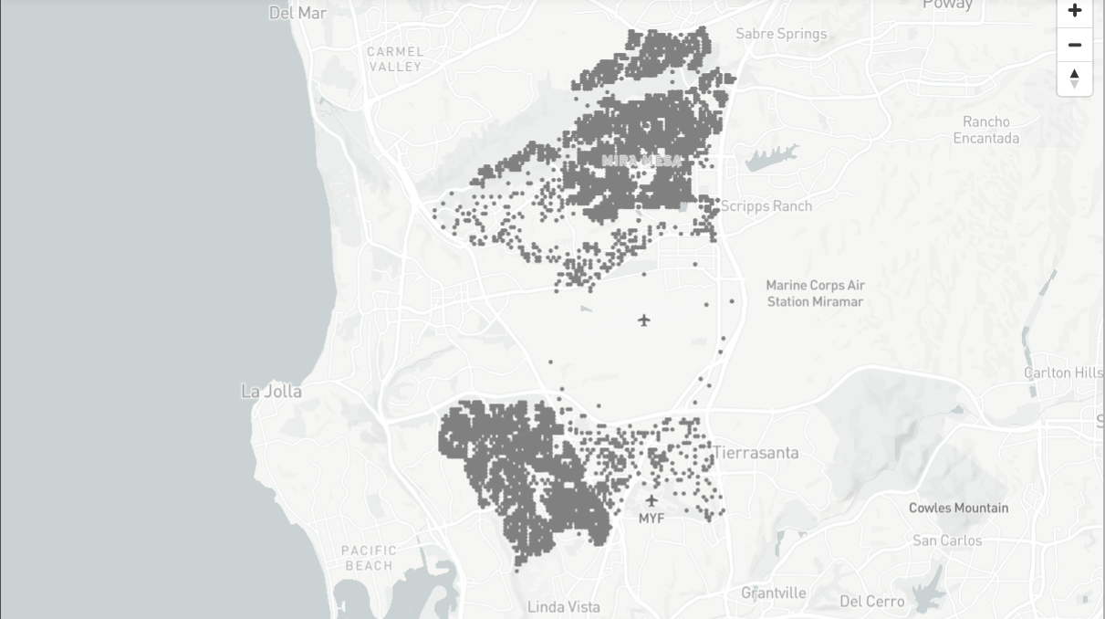
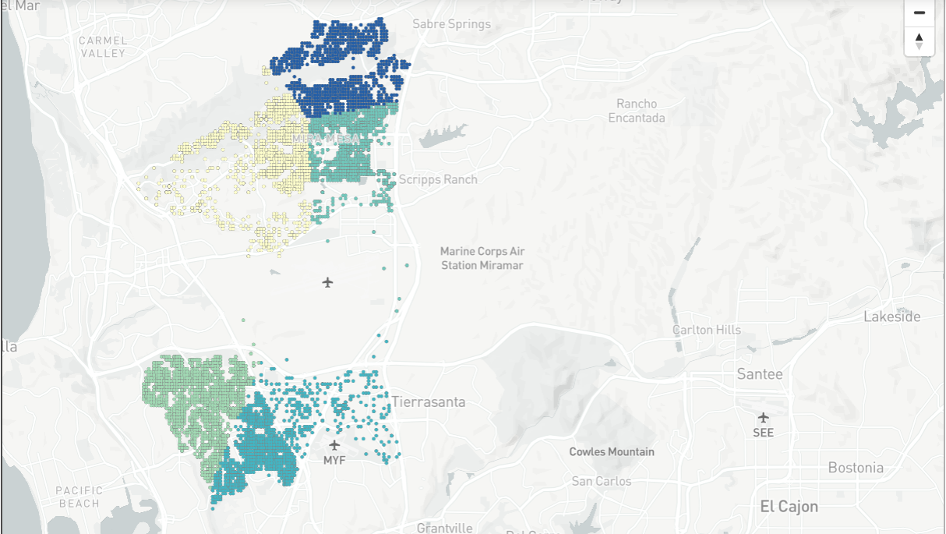
Prototype contd
Previous prototype- Using Jupyter Notebook, and a Mapbox Library
Visualizing voters from the original input list
Visualizing voters as various clusters after performing K-means clustering

Slide 25
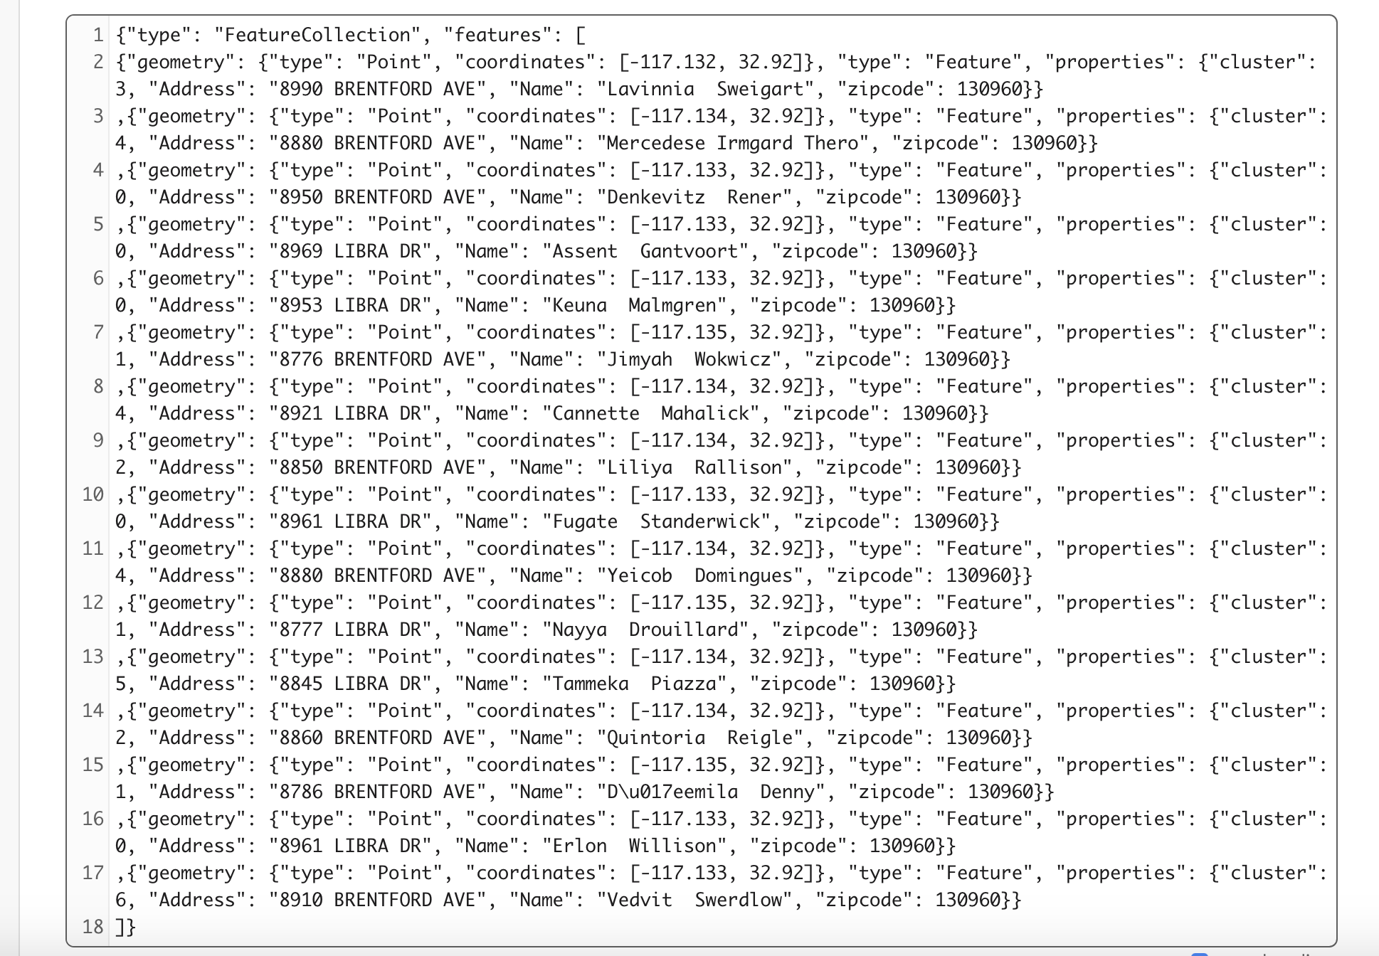
Prototype contd
Current Prototype (Back-end (Django)): Api response from Django Server
Cluster Information based on clustering algorithm
GeoJSON list of voters returned by the turf cutting algorithm. Each voter is assigned to a cluster based on the precinct they fall under, and the number of volunteers assigned to that precinct

Slide 26
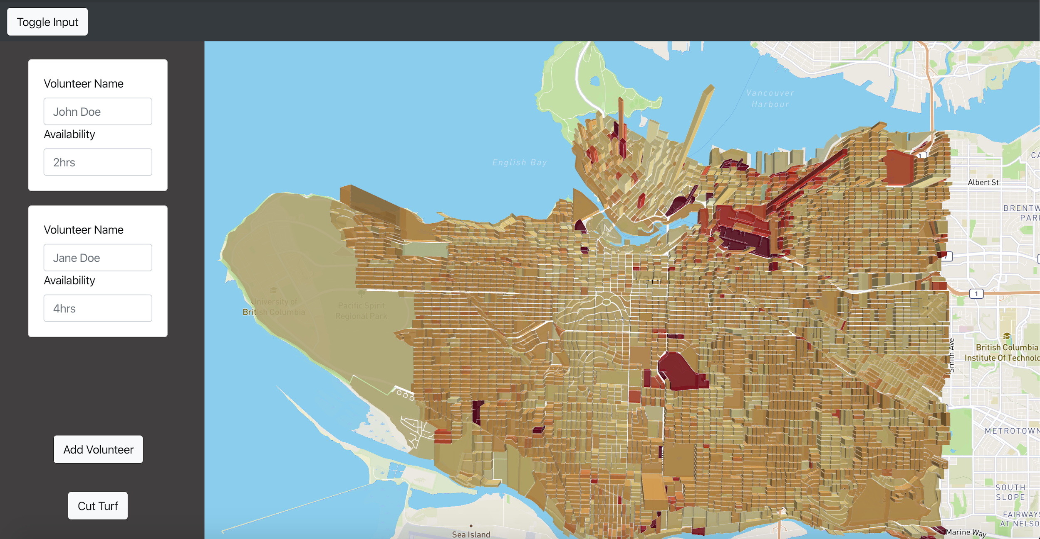
Prototype contd
Current Prototype (Front-end (React)): Visualization of GeoJSON
DeckGL layering visualization
Toggle Input menu
MapBox
Input form per volunteer
Add Volunteer Button
RESTApi Trigger on form submit
Sample Visualization using MapBox and DeckGL uber GeoJSON data

Slide 27
Architecture
Presented By Sahithi Velma

Slide 28
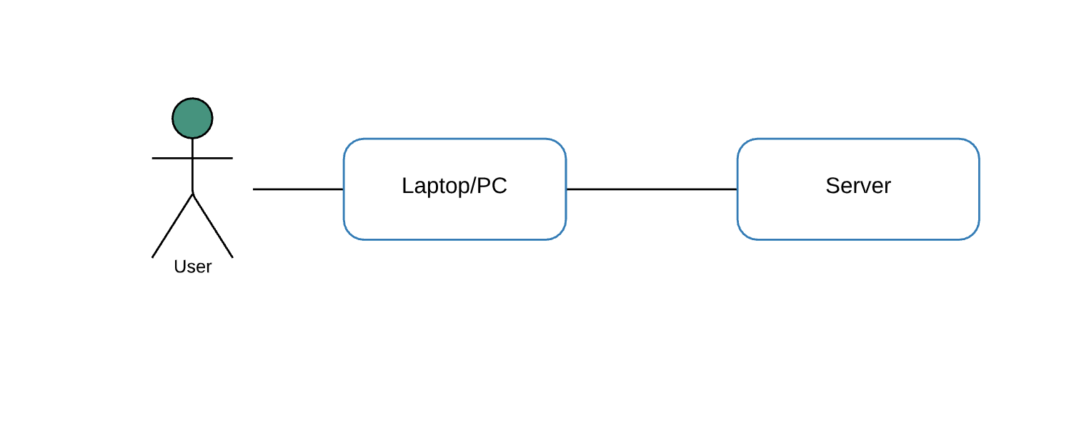
Top-Level Physical Architecture

Slide 29
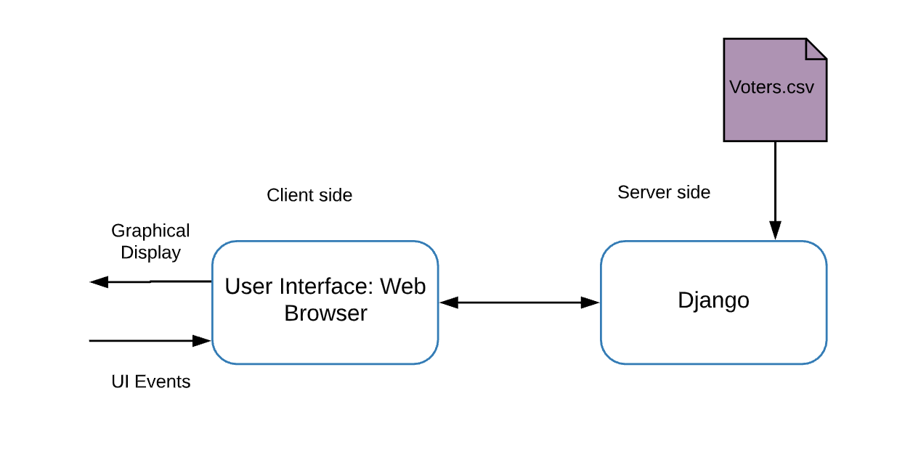
Top-Level Logical Architecture

Slide 30
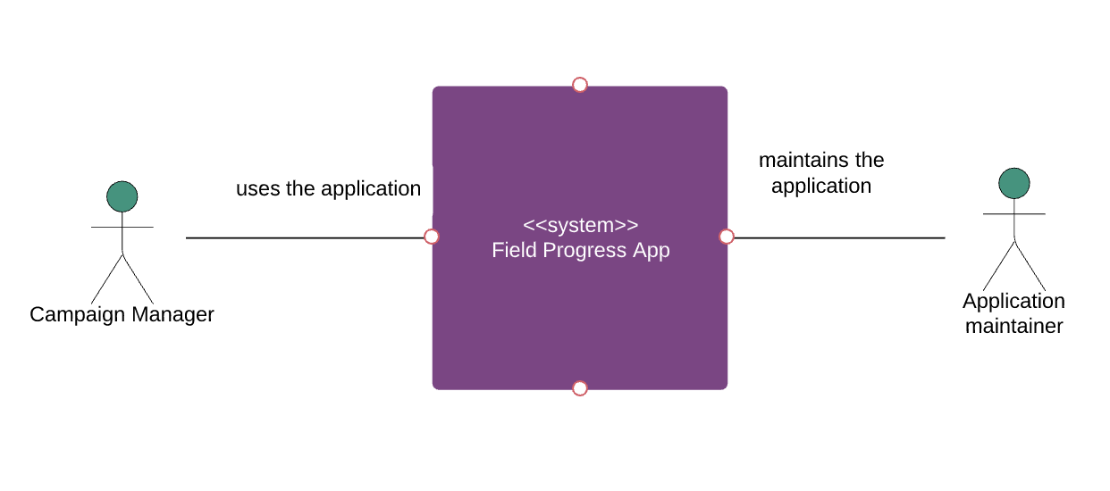
System Context Diagram

Slide 31
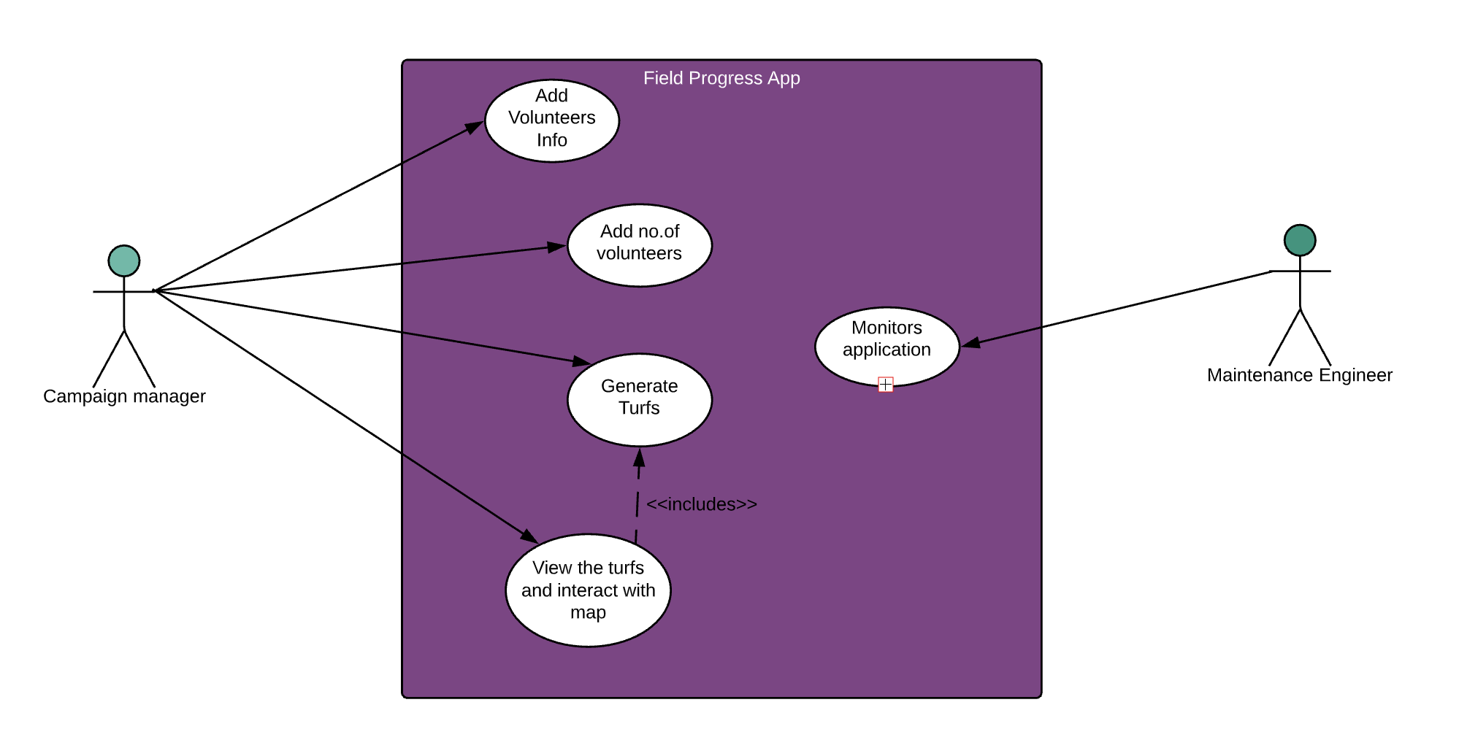
Use Case Diagram

Slide 32
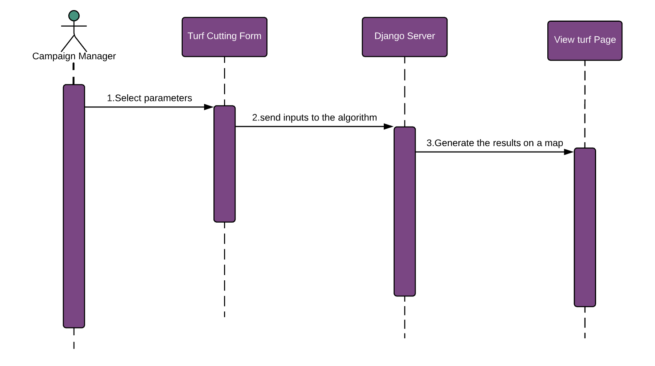
Sequence Diagram

Slide 33



NDI Status
COTS
React.js
Scikit learn
Pandas
MapBox
Deck.gl
Server
Django

Slide 34
Life Cycle Plan
Presented By Madhavi Shantharam

Slide 35
Life Cycle Plan
Purpose of Life Cycle Plan
Set milestones of each phase, identify deliverables, determine the technologies we should use , and estimate the project effort, schedule and cost, assign tasks to each team member and keep track of the development progress
Assumptions
1 semester project (12 weeks) Data provided by clients would be close to real scenario
Team
7 members in the team, 6 on-campus students and 1 DEN student

Slide 36
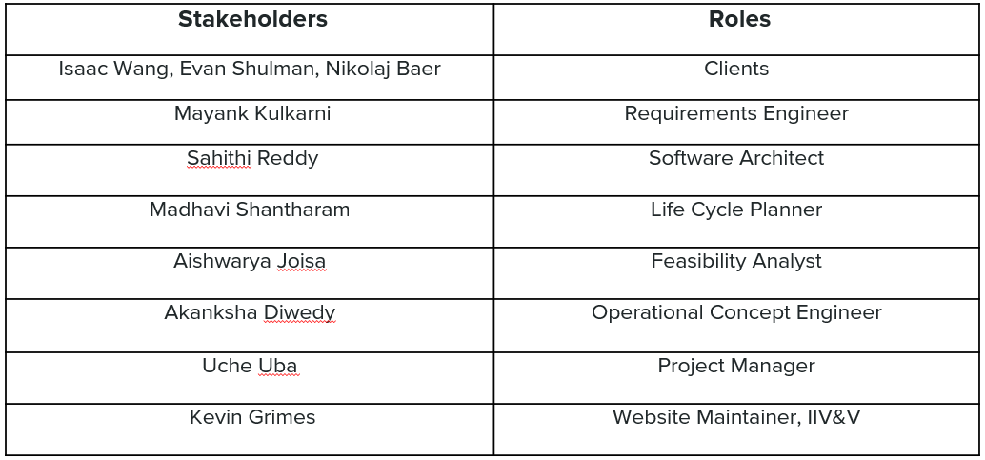
Life Cycle Plan
Key Stakeholder Responsibilities

Slide 37
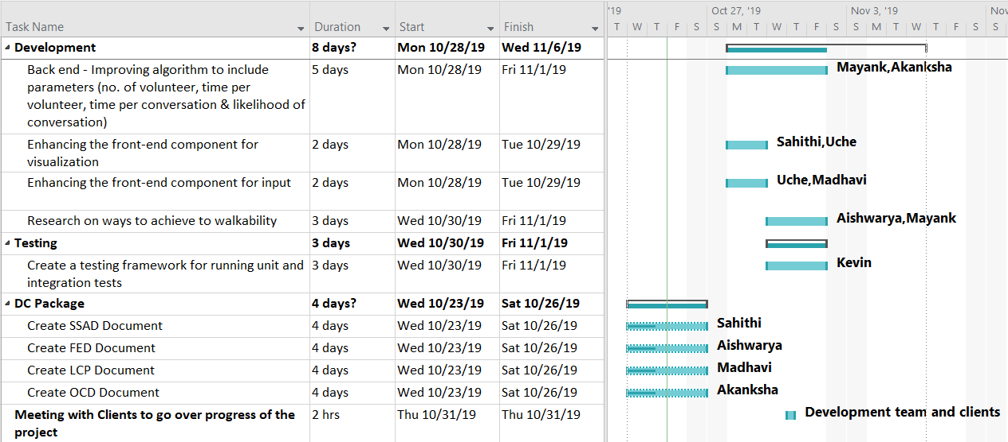
Life Cycle Plan
Project Plan
- Submit DC package by next week
- Focus on the following priorities
for the next two weeks
(1) Implementation of Turf Cutting
based on parameters
(2) Visualization & Testing
Turf Cutting: Improve the algorithm
to take time per
volunteer, time per conversation
and likelihood of conversation as
parameters
Visualization & Testing: Integration of
turf cutting module with visualization
tool to understand and improve the
effectiveness of the algorithm

Slide 38
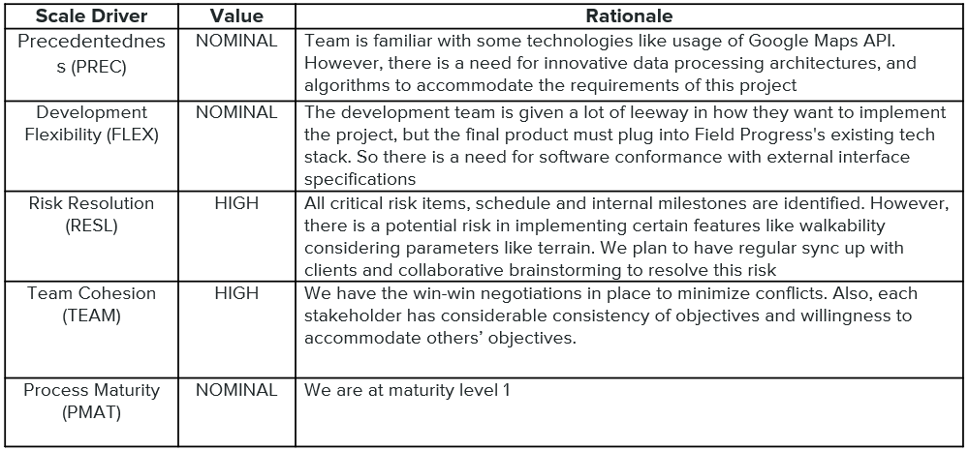
Life Cycle Plan
COCOMO II Scale Drivers

Slide 39
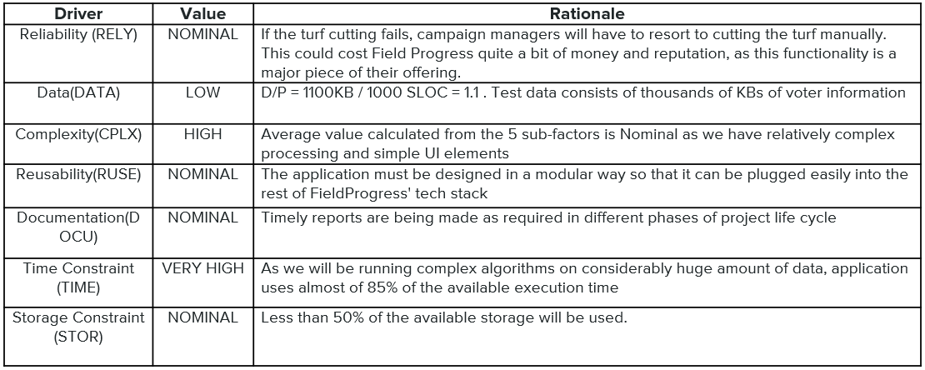
Life Cycle Plan COCOMO II Cost Drivers

Slide 40
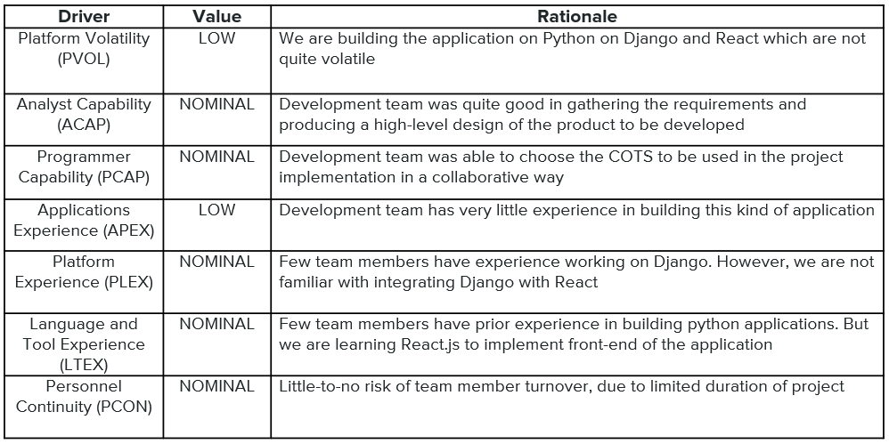
Life Cycle Plan COCOMO II Cost Drivers

Slide 41
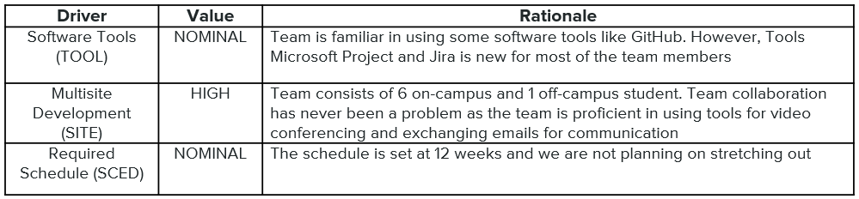
Life Cycle Plan COCOMO II Cost Drivers

Slide 42
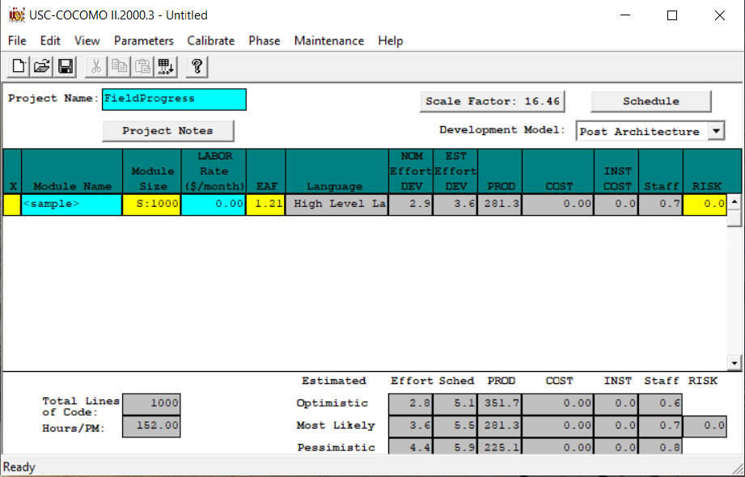
Life Cycle Plan
COCOMO II Results

Slide 43
Life Cycle Plan
COCOMO II Results
Estimated Size:
1000 SLOC
Estimated Effort:
Optimistic: 2.8 person-month x 152 = 425.6 person-hr
Most Likely: 3.6 person-month x 152 = 547.2 person-hr
Pessimistic: 4.4 person-month x 152 = 668.8 person-hr
Estimated Schedule:
Total work time of the whole team = 8 hr/week x 4 weeks x 7 team members = 224 hr/month
Optimistic: 425.6 / 224 = 1.9 months
Most Likely: 547.2 / 224 = 2.4 months
Pessimistic: 668.8 / 224 = 2.9 months

Slide 44
Feasibility Evidence
Presented By Aishwarya Joisa

Slide 45
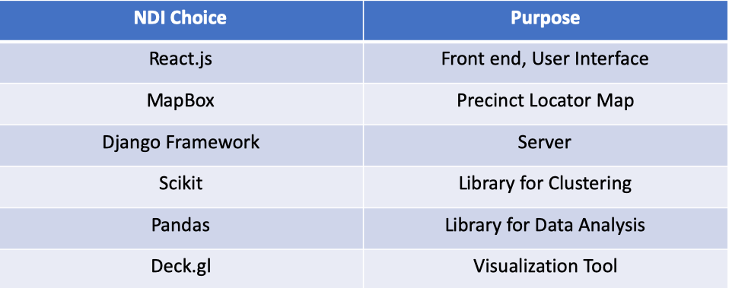
Feasibility Evidence Description
NDI Choice

Slide 46
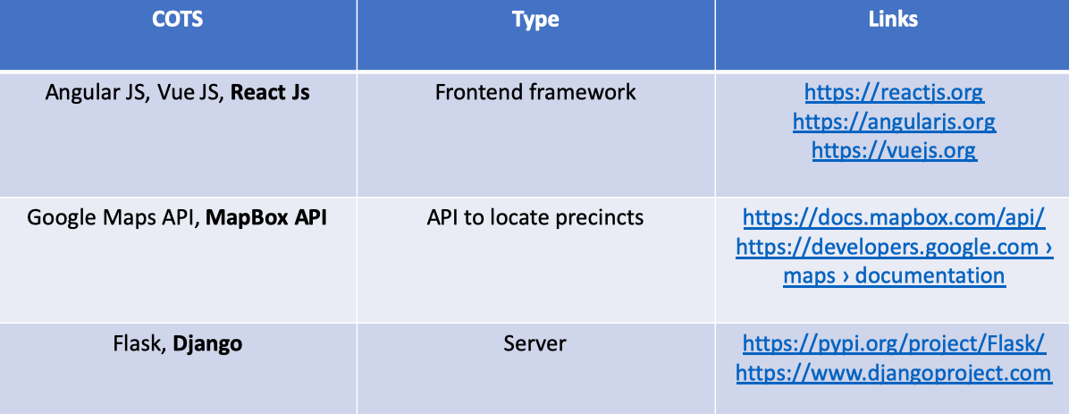
Feasibility Evidence Description
NDI/NCS Alternatives

Slide 47
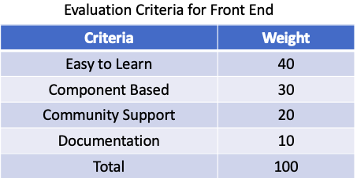
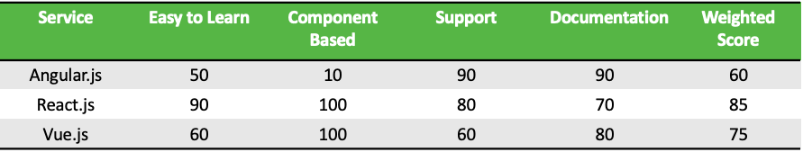
Feasibility Evidence Description
NDI/NCS Evaluation & Analysis Result

Slide 48
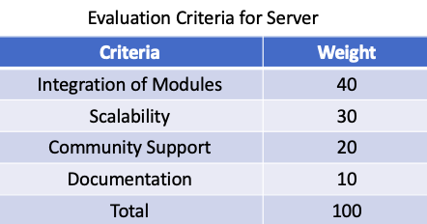
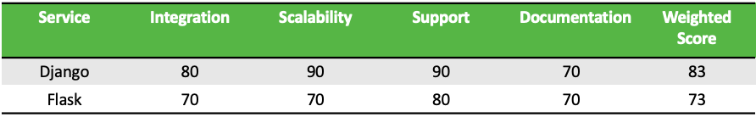
Feasibility Evidence Description
NDI/NCS Evaluation & Analysis Result

Slide 49
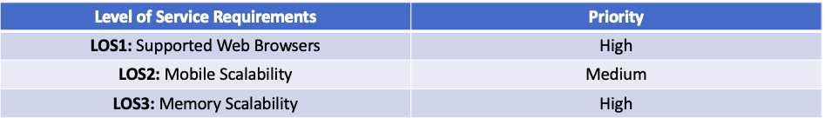
Feasibility Evidence Description
Level Of Service Goals(LOS)

Slide 50
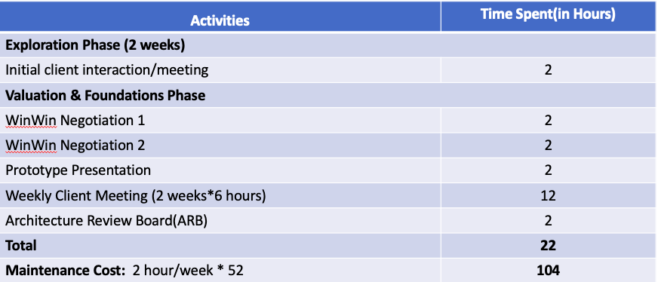
Feasibility Evidence Description
Personnel Costs

Slide 51
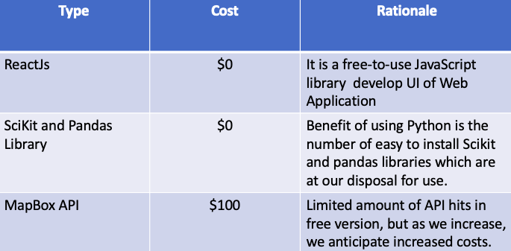
Feasibility Evidence Description
Hardware/ Software Costs

Slide 52
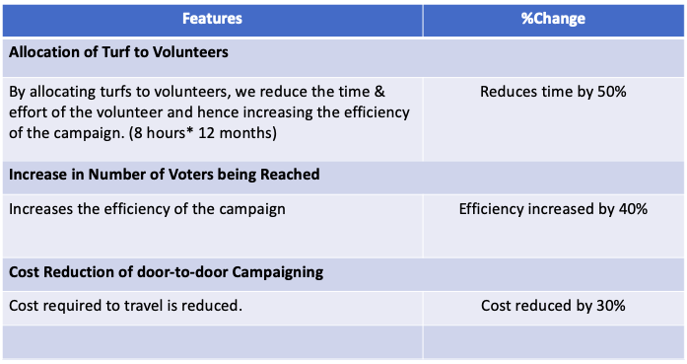
Feasibility Evidence Description
Benefit Analysis

Slide 53
Feasibility Evidence Description
RISK ASSESSMENT
Risk | Risk Exposure |  |  | Risk Mitigations
 | Potential Magnitude | Probability Loss | Risk Exposure
Lack of experience with programming in ReactJS | 7 | 5 | 35 | Team members will spend a couple of days studying and understanding React
Team Collaboration/Organisation | 3 | 3 | 15 | Open communication and delegation of tasks by the project manager is being enforced.

Slide 54
Feasibility Evidence Description
NDI Integration Conflict | 6 | 8 | 48 | Constant testing on these modules separately and together.
Third party library rendering our data | 6 | 7 | 45 | Manipulating the format of our data

Slide 55
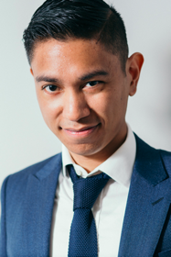
Feasibility Evidence Description
Persona #1
NAME: Frank Underwood
AGE: 32
GENDER: Male
LOCATION: Los Angeles
EDUCATION LEVEL: Post Graduate
POTENTIAL INCOME: $160000

Slide 56
Feasibility Evidence Description
User Stories: During campaigns, Frank always wants to ensure that the volunteers are always spending their time efficiently talking to voters, so he is always meticulous when assigning them turfs to go to, as he draws them out himself on a GIS tool.
Technical Lifestyle: Has an above average understanding in the use of excel as he uses it daily, has an Iphone and macbook. Sometimes feels bold enough to use the terminal on his mac, and considers himself tech savvy.

Slide 57
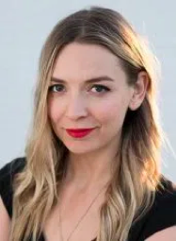
Feasibility Evidence Description
Persona #2
NAME: Sarah Liberman
AGE: 28
GENDER: Female
LOCATION: Seattle, LA
EDUCATION LEVEL: College Graduate
POTENTIAL INCOME: $210000

Slide 58
Feasibility Evidence Description
User Stories: As a novice to campaigning and campaign strategies, she seeks to always find new opportunities to optimize the time she spends doing campaign activities.
Technical Lifestyle: Basic computer Literacy. She uses her computer everyday, and spends a lot of her time using google and reading wiki pages. Also uses a fitbit to track her steps a day.

Slide 59

Feasibility Evidence Description
Persona #3
NAME: April John
AGE: 22
GENDER: Female
LOCATION: San Diego
EDUCATION LEVEL: Student
POTENTIAL INCOME: NIL

Slide 60
Feasibility Evidence Description
User Stories: Very enthusiastic student whose major is politics and very interested in efficient campaigning. She wants to do a study about the voters and their thought process about elections.
Technical Lifestyle: Quite efficient with computers. Uses a MacBook and IPhone on a daily basis and does her assignments and other daily work.

Slide 61
Quality Focal Point
Presented by Kevin Grimes

Slide 62
Quality Focal Point
Traceability Matrix
OCD | Requirement(s)
OC-1 Take voter data as input | WC_5507
OC-2 Take volunteer information | WC_5508
 | WC_5488
OC-3 Generate turfs within precincts | WC_5507
OC-4 Visualization of turfs | WC_5696
 | WC_5487
Four main capabilities
All SCS’ win-conditions satisfied
Test/use cases to be determined
Notes:
OC = “operational capability”

Slide 63
Quality Focal Point Quality and Configuration Management Strategies
Quality management – key factors
Scalability
Rigorous application testing on inputs of varying sizes
Developed as Python module with support for horizontal scaling
Performance
Algorithm optimized for precincts of around 10,000 people
Testing application on platforms of varying computational resources
Security
Sanitization of input parameters
Prevent SQL injection attacks and cross-site scripting

Slide 64





Quality Focal Point Quality and Configuration Management Strategies
Quality management – tooling
Jira
Tracks bugs, features, and other pieces of work
Collaborative environment
Pytest and Selenium (planned)
Automate testing procedures
Free up time for more development
Configuration management – tooling
Git
Retains all code versions
Changelog
Github
Enables collaboration across developers
Git interface
Jira logo: https://www.morosystems.com/products/atlassian-jira/; Pytest logo: https://docs.pytest.org; Selenium logo: https://seleniumhq.org; Git logo: https://git-scm.com; Github logo: https://github.com

Slide 65
Quality Focal Point Defect Identification Type Review Type Summary
Defect Identification Type | Description
Peer review | Each code change is documented in Github and Jira. Code changes are reviewed by developers and IIV&V to ensure high quality.
Grading | Feedback from TAs and professors from various reviews and assignments is taken into account.
Client feedback | Client interaction is critical to ensure that the components under development match their expectations.
Active defects: N/A
Notes:
We currently have no outstanding defects, as development is only beginning (pending architecture comments in this review).

Slide 66
Quality Focal Point Technical Debt
# | Description | Cat. #1 | Cat. #2 | Resolved | Mitigation plan | No. weeks active
1 | Lack of real-time test data | MPT shortfall | Prudent, deliberate | No | Actively working with clients to obtain real-time data. | 4
2 | Lack of React.js knowledge for frontend development | Personnel shortfall | Prudent, deliberate | Yes | Followed online tutorials and guides. | 2
More info: https://greenbay.usc.edu/csci577/fall2019/projects/team04/PR/Week05_Technical_Debt_F19a_T04.xlsx
Notes:
MPT: methods, processes, and tools

Slide 67
Quality Focal Point Technical Debt
# | Description | Cat. #1 | Cat. #2 | Resolved | Mitigation plan | No. weeks active
3 | Visualization code migration from Python to React.js | MPT shortfall | Prudent, deliberate | No | Investigating integration between Mapbox and React.js. | 2
4 | Integration of frontend and backend | MPT shortfall | Prudent, inadvertent | No | Actively exploring alternatives to interface between Python and React.js. | 1
More info: https://greenbay.usc.edu/csci577/fall2019/projects/team04/PR/Week05_Technical_Debt_F19a_T04.xlsx
Notes:
MPT: methods, processes, and tools

Slide 68
Quality Focal Point Technical Debt
# | Description | Cat. #1 | Cat. #2 | Resolved | Mitigation plan | No. weeks active
5 | No unit/integration test modules | Life cycle management shortfall | Reckless, inadvertent | No | Beginning to write tests as code base matures. | 0
6 | Precinct data was not provided by clients | Life cycle management shortfall | Prudent, inadvertent | Yes | Requested the data from the clients, which they provided. | 1
More info: https://greenbay.usc.edu/csci577/fall2019/projects/team04/PR/Week05_Technical_Debt_F19a_T04.xlsx
Notes:
MPT: methods, processes, and tools

Slide 69
Feedback

Slide 70
Backup

